Slide 1


CSCI 132: Basic Data Structures and Algorithms
Course Intro, Syllabus, and Logistics
Reese Pearsall
Spring 2025
https://www.cs.montana.edu/pearsall/classes/spring2025/232/main.html

Slide 2
To start things off, we are going to take a brief look at some of problems we are going to tackle in CSCI 232
We are going to find a cave and go treasure hunting

Slide 3

Given n cave entrances, where each cave entrance has an x,y coordinate, find the pair of caves with the smallest distance between them
(x,y)
(You can assume no caves have the same x or y values)

Slide 4
Given n cave entrances, where each cave entrance has an x,y coordinate, find the pair of caves with the smallest distance between them
(x,y)
(You can assume no caves have the same x or y values)

Slide 5
Given n cave entrances, where each cave entrance has an x,y coordinate, find the pair of caves with the smallest distance between them
(x,y)
(You can assume no caves have the same x or y values)
Algorithm ?

Slide 6
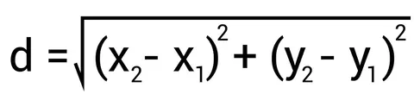
Given n cave entrances, where each cave entrance has an x,y coordinate, find the pair of caves with the smallest distance between them
(x,y)
(You can assume no caves have the same x or y values)
Algorithm ?

Slide 7
 | C1 | C2 | C3 | … | C9
C1 | / | D(1,2) | D(1,3) | … | D(1,9)
C2 | D(2,1) | / | D(2,3) | … | D(2,9)
C3 | D(3,1) | D(3,2) | / | … | D(3,9)
… | … | … | … | … | ….
C9 | D(9,1) | D(9,2) | D(9,3) | … | /
(x,y)
Algorithm ?

Slide 8
 | C1 | C2 | C3 | … | C9
C1 | / | D(1,2) | D(1,3) | … | D(1,9)
C2 | D(2,1) | / | D(2,3) | … | D(2,9)
C3 | D(3,1) | D(3,2) | / | … | D(3,9)
… | … | … | … | … | ….
C9 | D(9,1) | D(9,2) | D(9,3) | … | /
(x,y)
Basic solution:
Compute distance for each pair
Select smallest
Algorithm ?

Slide 9
 | C1 | C2 | C3 | … | C9
C1 | / | D(1,2) | D(1,3) | … | D(1,9)
C2 | D(2,1) | / | D(2,3) | … | D(2,9)
C3 | D(3,1) | D(3,2) | / | … | D(3,9)
… | … | … | … | … | ….
C9 | D(9,1) | D(9,2) | D(9,3) | … | /
(x,y)
Basic solution:
Compute distance for each pair
Select smallest
Running time = ?

Slide 10
 | C1 | C2 | C3 | … | C9
C1 | / | D(1,2) | D(1,3) | … | D(1,9)
C2 | D(2,1) | / | D(2,3) | … | D(2,9)
C3 | D(3,1) | D(3,2) | / | … | D(3,9)
… | … | … | … | … | ….
C9 | D(9,1) | D(9,2) | D(9,3) | … | /
(x,y)
Basic solution:
Compute distance for each pair
Select smallest
Running time = ?
Running time = O(n²)
n = # of caves

Slide 11
Now things get a bit messier. Our table is going to much larger, and will take more time to compute

Slide 12
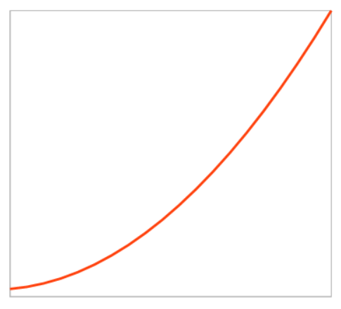

Algorithms
Remember, we are concerned with our algorithm performs as some input n grows
Running Time
n

Slide 13

Remember, we are concerned with our algorithm performs as some input n grows
Can we do better?
Running Time
n

Slide 14












We can reach the cave through a series of roads, each having a distance of d
8
3
5
4
There are several ways to get there!
7
6
6
3
5
14
2

Slide 15













We can reach the cave through a series of roads, each having a distance of d
8
3
5
4
There are several ways to get there!
7
6
6
Cost: 23 (3 + 7 + 5 + 8)
3
5
14
2

Slide 16



We can reach the cave through a series of roads, each having a distance of d
8
3
5
4
There are several ways to get there!
7
6
6
Cost: 19 (2 + 14 + 3)
3
5
14
2

Slide 17
We can reach the cave through a series of roads, each having a distance of d
8
3
5
4
There are several ways to get there!
7
6
6
5
What is the shortest path from start to finish?
14
3
2

Slide 18
We can reach the cave through a series of roads, each having a distance of d
8
3
5
4
There are several ways to get there!
7
6
6
5
What is the shortest path from start to finish?
14
3
Brute Force?
2

Slide 19
Graph
We can reach the cave through a series of roads, each having a distance of d
8
3
5
4
There are several ways to get there!
7
6
6
5
What is the shortest path from start to finish?
14
3
Brute Force?
2
Brute forcing every possible path is not feasible
(ie exponential or factorial time)
It is ok for this map, but we want our approach to work on every possible map

Slide 20




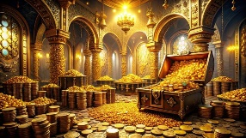























We have now reached the cave, but the cave consists of many complex tunnels

Slide 21























We have now reached the cave, but the cave consists of many complex tunnels
How should they explore this cave?
What are the different ways they could explore it?

Slide 22



We have now reached the cave, but the cave consists of many complex tunnels
How should they explore this cave?
What are the different ways they could explore it?

Slide 23







We have now reached the cave, but the cave consists of many complex tunnels
Explore each level before going to the next layer below

Slide 24

We have now reached the cave, but the cave consists of many complex tunnels
How should they explore this cave?
What are the different ways they could explore it?

Slide 25



We have now reached the cave, but the cave consists of many complex tunnels
Go as far as you can before you backtrack

Slide 26






We have now reached the cave, but the cave consists of many complex tunnels
Go as far as you can before you backtrack
This may be the better approach if we know the thing we are looking for is deep in the cave

Slide 27
We have now reached the cave, but the cave consists of many complex tunnels
Explore each level before going to the next layer below
Go as far as you can before you backtrack

Slide 28






















We have now reached the cave, but the cave consists of many complex tunnels
Tree
Explore each level before going to the next layer below
Go as far as you can before you backtrack
Tree Traversal Methods

Slide 29

We have reached the treasure room, but there is much more treasure than our backpack can fit
We must pick what treasure we want to take !

Slide 30







Value: 10
Weight: 5
Value: 40
Weight: 4
Value: 30
Weight: 6
Value: 25
Weight: 4
Value: 50
Weight: 3
Value: 5
Weight: 2
We are going to steal some items fand put them into our backpack
Each item has a weight, and a value
Goal: Steal items such that we maximize the value of items being stole, while not overfilling our backpack
Our backpack can only fill 10 pounds

Slide 31

Value: 10
Weight: 5
Value: 40
Weight: 4
Value: 30
Weight: 6
Value: 25
Weight: 4
Value: 50
Weight: 3
Value: 5
Weight: 2
We are going to steal some items fand put them into our backpack
Each item has a weight, and a value
Goal: Steal items such that we maximize the value of items being stole, while not overfilling our backpack
Total value: 70
Weight: 10 pounds
Our backpack can only fill 10 pounds

Slide 32
Value: 10
Weight: 5
Value: 40
Weight: 4
Value: 30
Weight: 6
Value: 25
Weight: 4
Value: 50
Weight: 3
Value: 5
Weight: 2
We are going to steal some items fand put them into our backpack
Each item has a weight, and a value
Goal: Steal items such that we maximize the value of items being stole, while not overfilling our backpack
Algorithm?
Our backpack can only fill 10 pounds

Slide 33
Value: 10
Weight: 5
Value: 40
Weight: 4
Value: 30
Weight: 6
Value: 25
Weight: 4
Value: 50
Weight: 3
Value: 5
Weight: 2
We are going to steal some items fand put them into our backpack
Each item has a weight, and a value
Goal: Steal items such that we maximize the value of items being stole, while not overfilling our backpack
Algorithm?
Stuff our backpack with the most expensive items until we can’t fit anymore
Our backpack can only fill 10 pounds

Slide 34
Value: 10
Weight: 5
Value: 40
Weight: 4
Value: 30
Weight: 6
Value: 25
Weight: 4
Value: 50
Weight: 3
Value: 5
Weight: 2
We are going to steal some items fand put them into our backpack
Each item has a weight, and a value
Goal: Steal items such that we maximize the value of items being stole, while not overfilling our backpack
Algorithm?
Stuff our backpack with the most expensive items until we can’t fit anymore
Our backpack can only fill 10 pounds

Slide 35

Value: 10
Weight: 5
Value: 40
Weight: 4
Value: 30
Weight: 6
Value: 25
Weight: 4
Value: 50
Weight: 3
Value: 5
Weight: 2
We are going to steal some items fand put them into our backpack
Each item has a weight, and a value
Goal: Steal items such that we maximize the value of items being stole, while not overfilling our backpack
Value: 95
Weight: 9
Our backpack can only fill 10 pounds

Slide 36

Value: 10
Weight: 5
Value: 40
Weight: 4
Value: 30
Weight: 6
Value: 25
Weight: 4
Value: 50
Weight: 3
Value: 5
Weight: 2
We are going to steal some items fand put them into our backpack
Each item has a weight, and a value
Goal: Steal items such that we maximize the value of items being stole, while not overfilling our backpack
Is this the optimal solution?
Value: 95
Weight: 9
Our backpack can only fill 10 pounds

Slide 37
Value: 10
Weight: 5
Value: 40
Weight: 4
Value: 30
Weight: 6
Value: 25
Weight: 4
Value: 50
Weight: 8
Value: 5
Weight: 2
We are going to steal some items fand put them into our backpack
Each item has a weight, and a value
Goal: Steal items such that we maximize the value of items being stole, while not overfilling our backpack
Is this the optimal solution?
Value:
Weight:
Our backpack can only fill 10 pounds

Slide 38
Value: 10
Weight: 5
Value: 40
Weight: 4
Value: 30
Weight: 6
Value: 25
Weight: 4
Value: 50
Weight: 8
Value: 5
Weight: 2
We are going to steal some items fand put them into our backpack
Each item has a weight, and a value
Goal: Steal items such that we maximize the value of items being stole, while not overfilling our backpack
Is this the optimal solution?
Value: 55
Weight: 10
Our backpack can only fill 10 pounds

Slide 39




Value: 10
Weight: 5
Value: 40
Weight: 4
Value: 30
Weight: 6
Value: 25
Weight: 4
Value: 50
Weight: 8
Value: 5
Weight: 2
We are going to steal some items fand put them into our backpack
Each item has a weight, and a value
Goal: Steal items such that we maximize the value of items being stole, while not overfilling our backpack
Is this the optimal solution?
Value: 55
Weight: 10
Our backpack can only fill 10 pounds

Slide 40
Value: 10
Weight: 5
Value: 40
Weight: 4
Value: 30
Weight: 6
Value: 25
Weight: 4
Value: 50
Weight: 8
Value: 5
Weight: 2
We are going to steal some items fand put them into our backpack
Each item has a weight, and a value
Goal: Steal items such that we maximize the value of items being stole, while not overfilling our backpack
Optimization
Our backpack can only fill 10 pounds

Slide 41

Suppose we want to keep a record of which person has which treasures, ie a ledger
Reese:
Bob:
Iliana:

Slide 42

Suppose we want to keep a record of which person has which treasures, ie a ledger
Key-Value Pairs
Reese:
Bob:
Iliana:
Name : Bag
Hash Tables

Slide 43
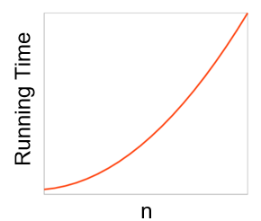
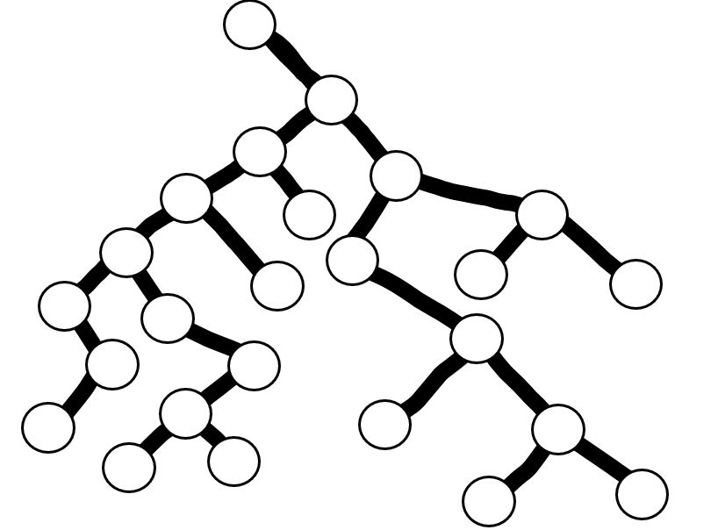
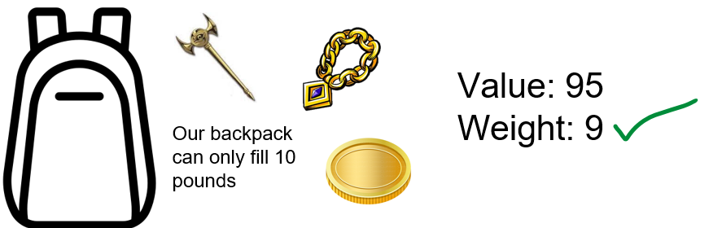
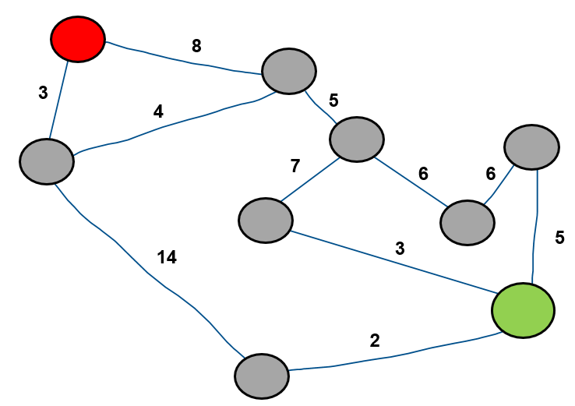
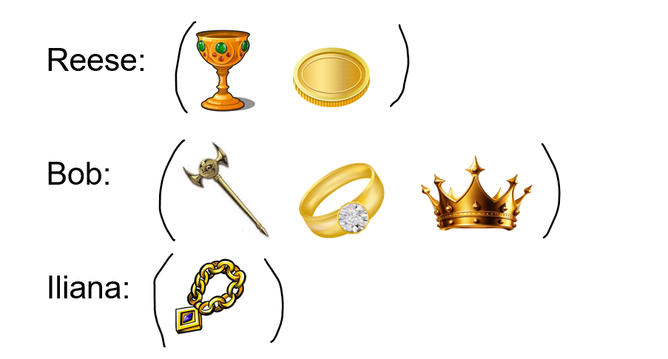
CSCI 232
Algorithms
Trees
Optimization
Graphs
Hash Tables

Slide 44

Our Goals for this Semester
Code (a lot) (in Java)

Slide 45
Our Goals for this Semester
Code (a lot) (in Java)
Learn about more data structures we can use in our programs (and tradeoffs)

Slide 46
Our Goals for this Semester
Code (a lot) (in Java)
Learn about more data structures we can use in our programs (and tradeoffs)
Learn about more strategies/types of algorithms to solve problems

Slide 47
Our Goals for this Semester
Code (a lot) (in Java)
Learn about more data structures we can use in our programs (and tradeoffs)
Learn about more strategies/types of algorithms to solve problems
Be able to formally detail the performance of an algorithm and identify factors limiting that performance

Slide 48
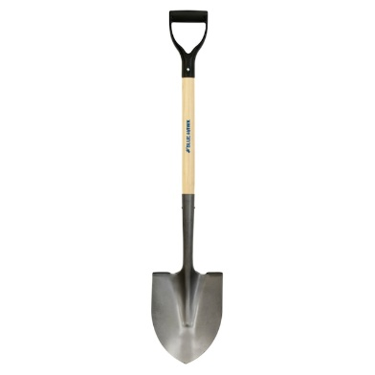

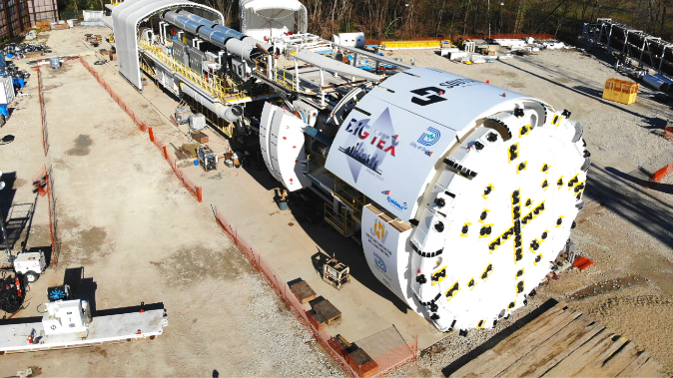
What do you need to dig a hole?
Pros
Cons

Slide 49
What do you need to dig a hole?
Pros
Cons
Cheap
Precise
No Training
Availability
Each tool has their pros, cons, and tradeoffs
Slow
Labor
Fast
Labor
Expensive
Training
Really good at digging
Takes up a lot of garage space

Slide 50
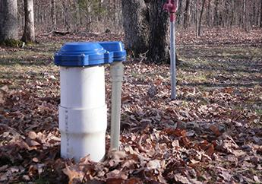
What do you need to dig a hole?
Pros
Cons
Cheap
Precise
No Training
Availability
Best tool for the job?
Slow
Labor
Digging a Well for water
Fast
Labor
Expensive
Training
Really good at digging
Takes up a lot of garage space

Slide 51
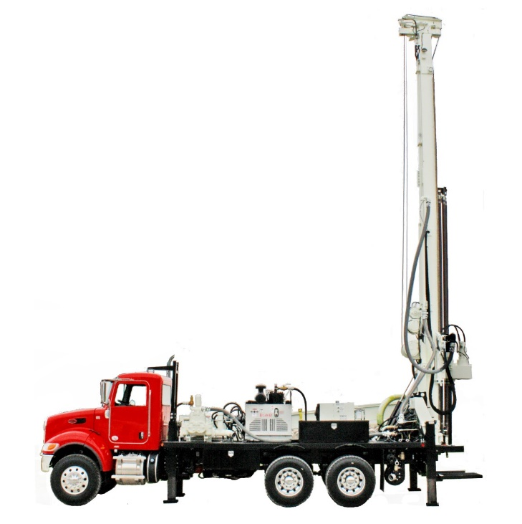
What do you need to dig a hole?
Pros
Cons
Cheap
Precise
No Training
Availability
Best tool for the job?
Slow
Labor
Digging a Well for water
Fast
Labor
Expensive
Training
Really good at digging
Takes up a lot of garage space

Slide 52
What do you need to dig a hole?
Pros
Cons
Cheap
Precise
No Training
Availability
Best tool for the job?
Slow
Labor
Digging a Well for water
We can’t use the best tool for the job unless we know that tool exists!
Fast
Labor
Expensive
Training
Really good at digging
Takes up a lot of garage space

Slide 53
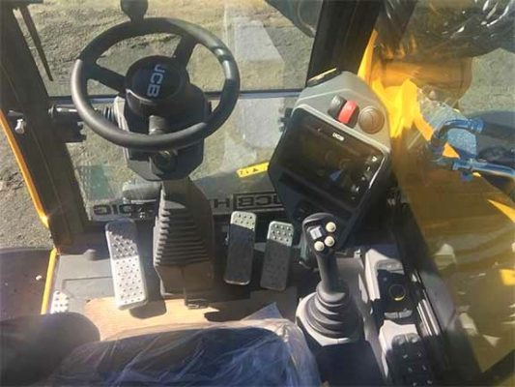
What do you need to dig a hole?
Pros
Cons
Cheap
Precise
No Training
Availability
Slow
Labor
Fast
Labor
Expensive
Training
Really good at digging
Takes up a lot of garage space

Slide 54
What do you need to dig a hole?
Pros
Cons
Cheap
Precise
No Training
Availability
Slow
Labor
Fast
Labor
Expensive
Training
We can’t use the best tool for the job unless we know how to use that tool
Really good at digging
Takes up a lot of garage space

Slide 55


CSCI 232- Data Structures and Algorithms
“Tools”
Arrays
Linked Lists
Stacks/Queues
Hash Tables
Trees
Graphs
“Use of tools”
Sorting
Searching
Routing
Optimization
A data structure is a mechanism for storing and organizing data
An algorithm is a series of instructions to be followed to solve some problem

Slide 56
This class is critical
Learn important set of tools to solve problems
Become autonomous programmers, no more hand holding
All other CS classes build on this*
Job interview questions use stuff from this class
I want this class to challenge you !

Slide 57
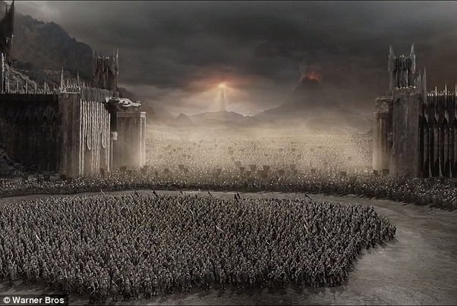
Literally every upper division CS class
CSCI 232
CS students

Slide 58

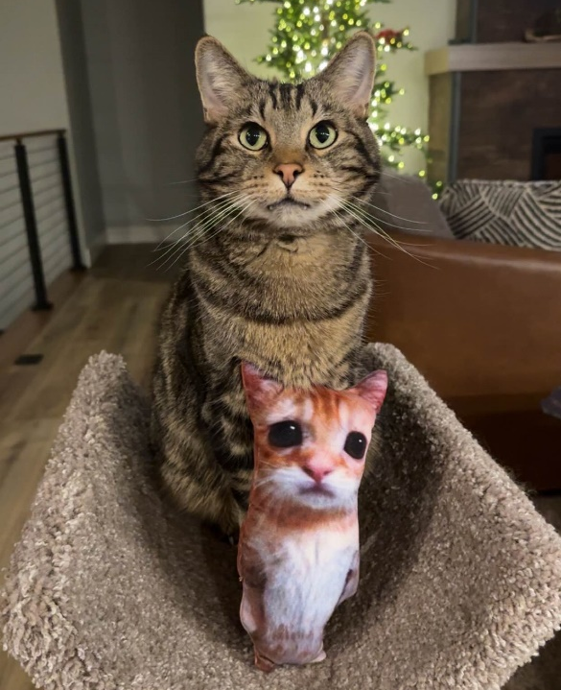

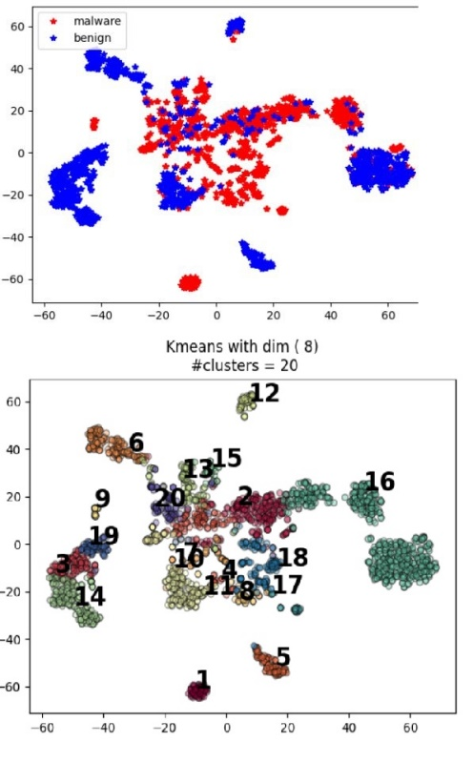
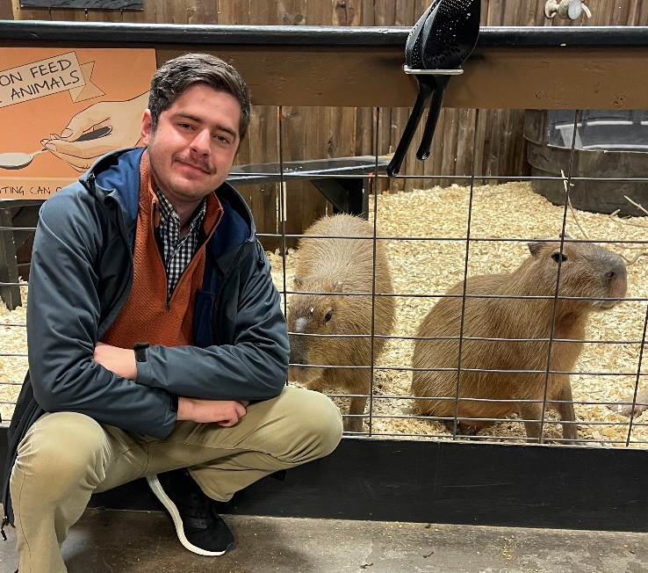
Reese Pearsall
You can just call me “Reese” ☺
(pierce-all)
Third year Instructor @MSU
B.S & M.S @ MSU
Hometown
Billings, MT
Interests
Cybersecurity
Malware analysis and detection
Cybercrime
Computer Science Education
Teaching
CSCI 132
CSCI 232
ESOF 422
Meatball
Favorite Fast Food
Blaze Pizza
McDonalds
Experience
Software Engineer and Tester, Techlink (Bozeman)
Software Engineer, United States Air Force (Hill AFB, Utah)
Cybersecurity Software Engineer, Hoplite Industries (Bozeman)
Graduate Researcher, MSU (Bozeman)
Outside of academia
Video games, New England Patriots, Fantasy Football, TikTok (rip), Dr Pepper, Memes, The Bachelor, Naps

Slide 59


There may be a time I have to cancel class due to feeling unwell
I will always announce ahead of time if a class is cancelled (email, D2L announcement, Discord)

Slide 60

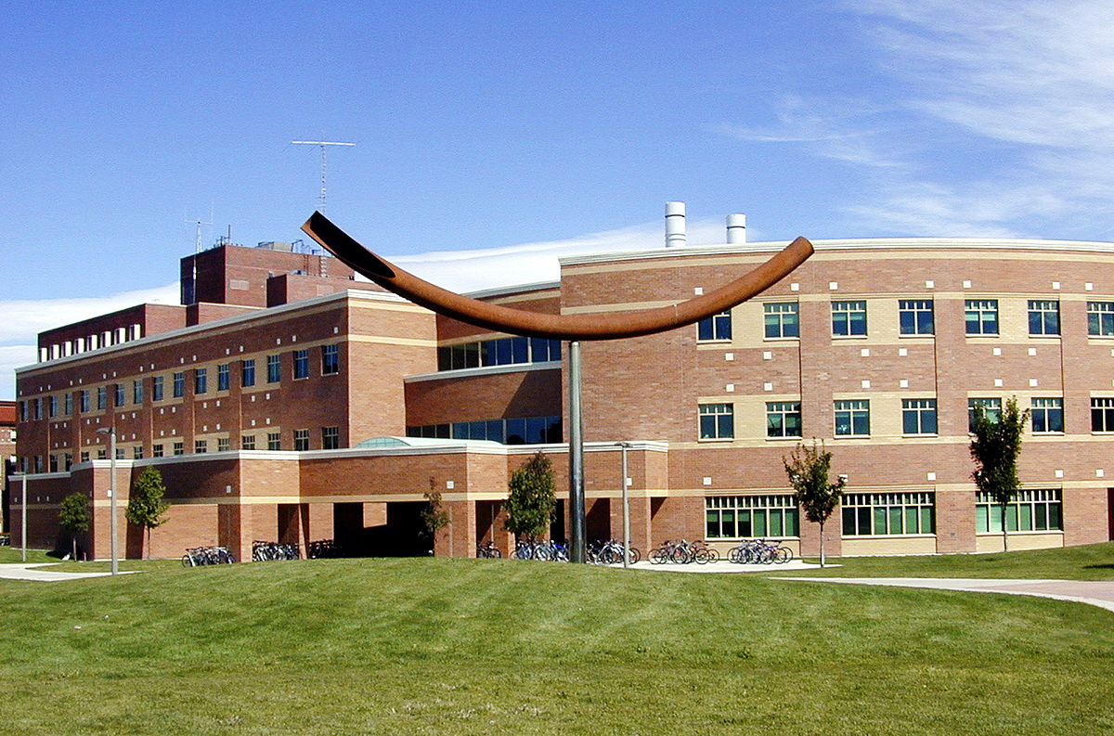
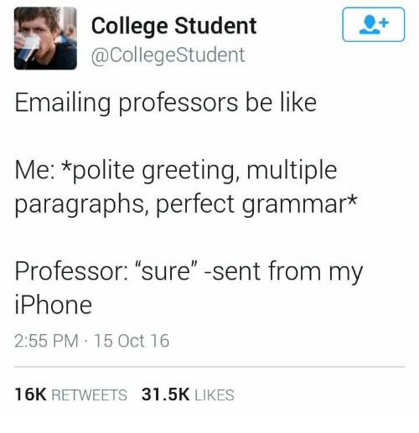


Contact
Email: reese.pearsall@montana.edu (I will respond as soon as I can)
Office Hours: Tuesday, Wednesday and Friday 12:00 PM – 1:00PM
Office: Barnard Hall 361
I am also very responsive on Discord!
(@reese_p)

Slide 61
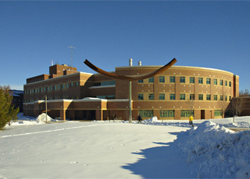
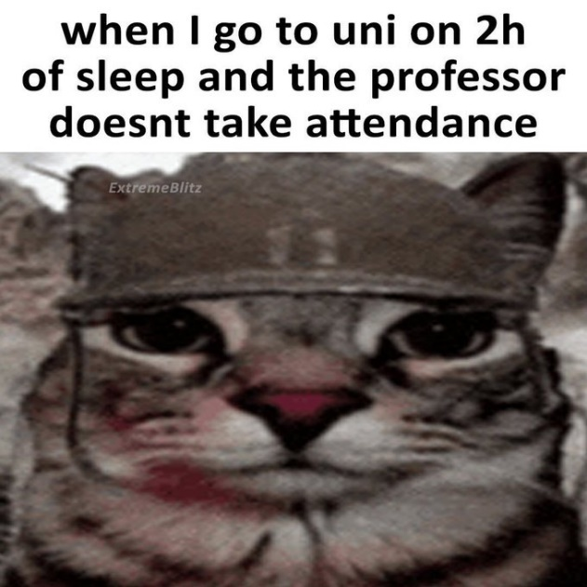
Course Logistics (Lecture)
Class Meetings
TR: 10:50 AM – 12:05 PM
Barnard Hall 103
All lectures will be recorded and posted on the course website
(coming to class is still a good idea)
We will be doing lots of live coding during lecture, so it might be helpful if you bring your own laptop to class (if you would like to code along)
Please be respectful and considerate of your classmates siting around you

Slide 62
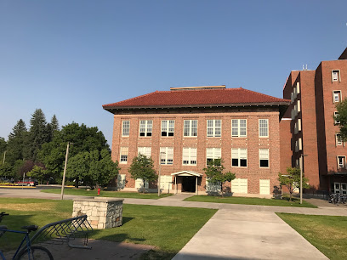

Course Logistics (Lab)
Section 003- Fridays 10:00 - 11:50 AM
Section 004- Fridays 12:00 - 2:00 PM
Section 005- Fridays 2:10 - 4:00 PM
Locations: Roberts 111
You can go to lab and get help from your TA and lab assistants
Lab attendance is optional
Lab assignments will be posted a few days before Fridays and can be completed from home.
You can attend a different lab section earlier/later in the day if you would like

Slide 63
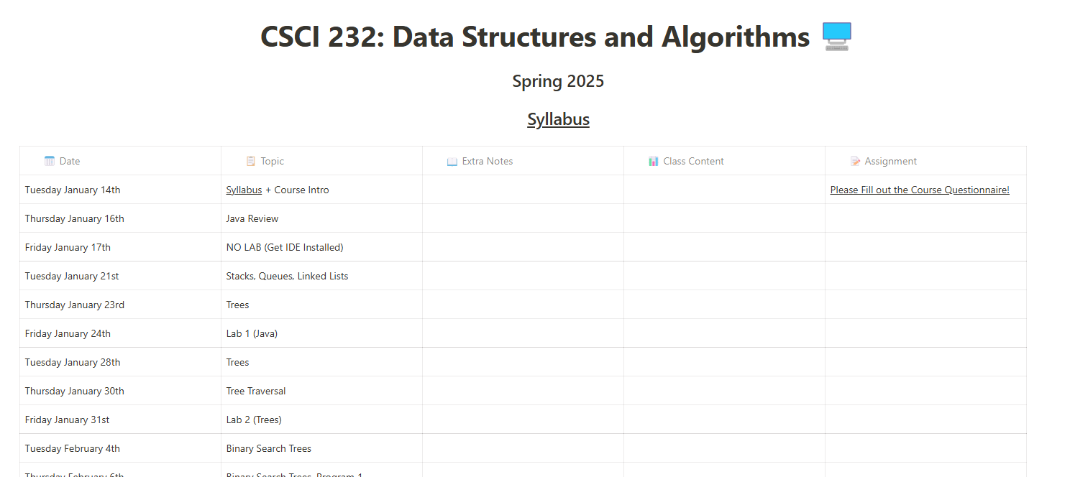

Course Logistics
You will be visiting this website a lot… be sure to bookmark it!
https://www.cs.montana.edu/pearsall/classes/spring2025/232/main.html
You also will need to join our Discord server!
Please set your Discord nickname to your name
Get 232 notifications by typing !join-232

Slide 64
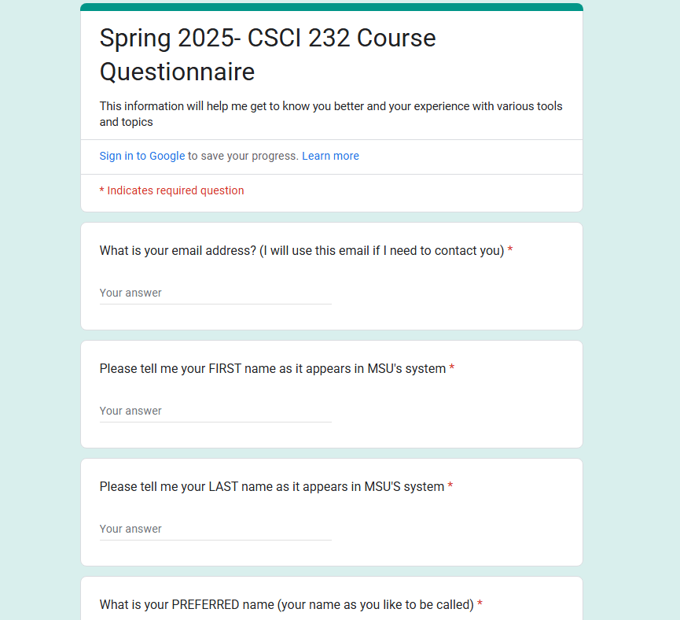
Course Questionnaire
Please take some time this week to fill out the course questionnaire ☺

Slide 65
Prerequisites
CSCI 132- Basic Data Structures and Algorithms (Required)
CSCI 246- Discrete Structures (Recommended)
You will be totally fine if you have taken CSCI 246
Before taking this class, you should feel comfortable basic Java programming, be comfortable using the following data structures: arrays, linked lists, stacks, queues, be comfortable with basic recursion, and how to analyze an algorithm using big-O notation
(If you are not familiar with any of this stuff, you should take some time to review it this week. My CSCI 132 course is available and may be helpful)

Slide 66
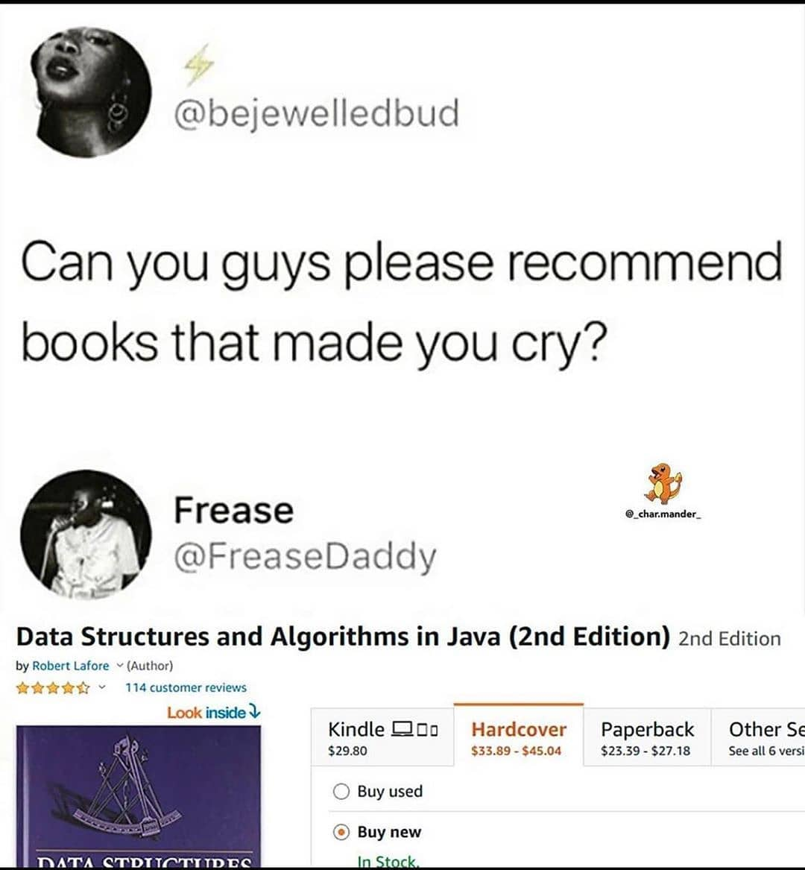
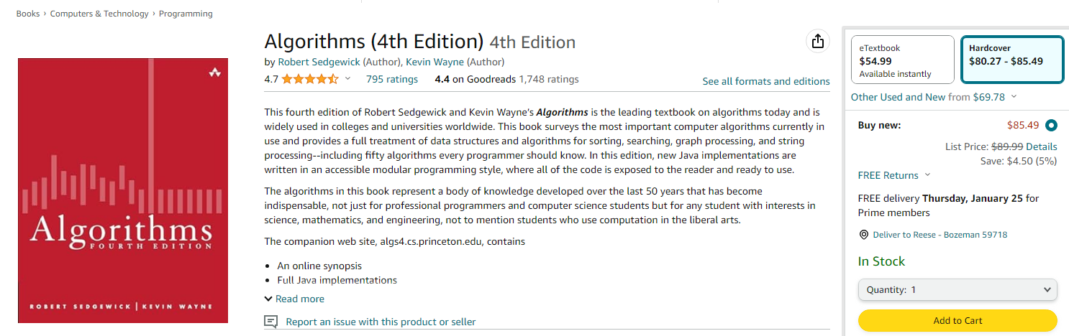
Textbook
(Optional) Algorithms (4th Edition) by Sedgewick and Wayne.
unfortunately, a very relatable meme
This textbook is not required
(but it does have tons of great stuff!!)

Slide 67
Grading
35% - Labs (10 @ ~3.5% each)
45% - Programs (5 @ 9% each)
20% Quizzes (3 @ 6.67% each)

Slide 68
Grading
Labs (35%)
Shorter, weekly assignments.
Can generally be finished within 1-2.5 hours
Due on Friday nights @ 11:59 PM
I will post the labs a few days ahead of time
You are usually given starting code
You should be able to finish within your 2hr lab time
Individual submissions

Slide 69
Grading
Programs (45%)
Longer, more complicated programming assignments
Will likely take 2+ hours to complete
You will always have 2-3 weeks to complete them
Write code from scratch
Much higher stakes, make sure you give yourself plenty of time to complete them
You can get help from your TA during lab time, or office hours, or from Reese, or on Discord
You are allowed to work with 1 partner

Slide 70
Grading
Quizzes (20%)
There will be three quizzes this semester (Friday 2/28, 3/28, 4/25)
They are taken online through Brightspace/D2L (autograded)
Conceptual questions
→ Multiple Choice
→ True False
Matching
You must take the quiz in Roberts Hall 111 (You can bring your laptop). You must attend the lab section that you are registered for.
The TAs will be keeping track of who has come/left Roberts 111
→ If you take the quiz from home, you quiz grade will face a harsh penalty
You can use any notes, past assignments, lecture recordings, slides, documentation, etc

Slide 71
Grading Deductions/Late assignments
If you submit late, but you are within < 24 of the original. You will face a -25% penalty
If you submit late, but you are within < 48 of the original. You will face a -50% penalty
Any assignment submitted 48+ hours after the deadline will not be accepted
You must submit code that compiles. Code that does not compile will receive an automatic 0%.
If your code compiles and runs, but doesn’t work, or has runtime errors later on, that is ok.
Your TA or I should not need to fix your code in order for it to compile and run

Slide 72

Extra Credit (1%)
We will be looking at and solving LeetCode problems throughout the semester.
LeetCode is a website that helps people enhance their coding skills and prepare them for coding interviews.
LeetCode is a great way to get better at programming, and many of the thousands of coding problems are very related to CSCI 232 !
If you create a LeetCode account and solve at least 2 problems, you will earn 1% added to your final grade!
Exact submission details tbd

Slide 73
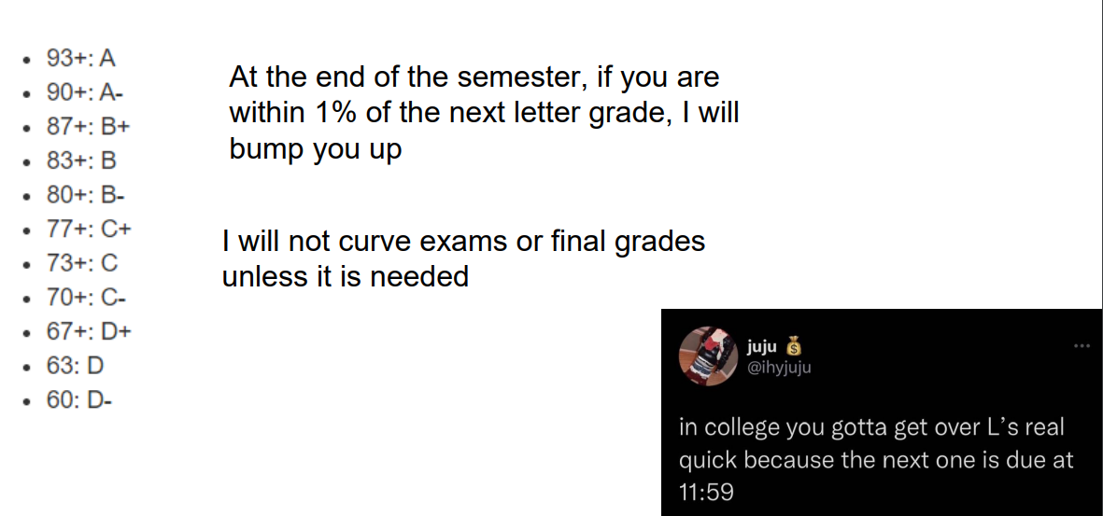
Grading Scale

Slide 74
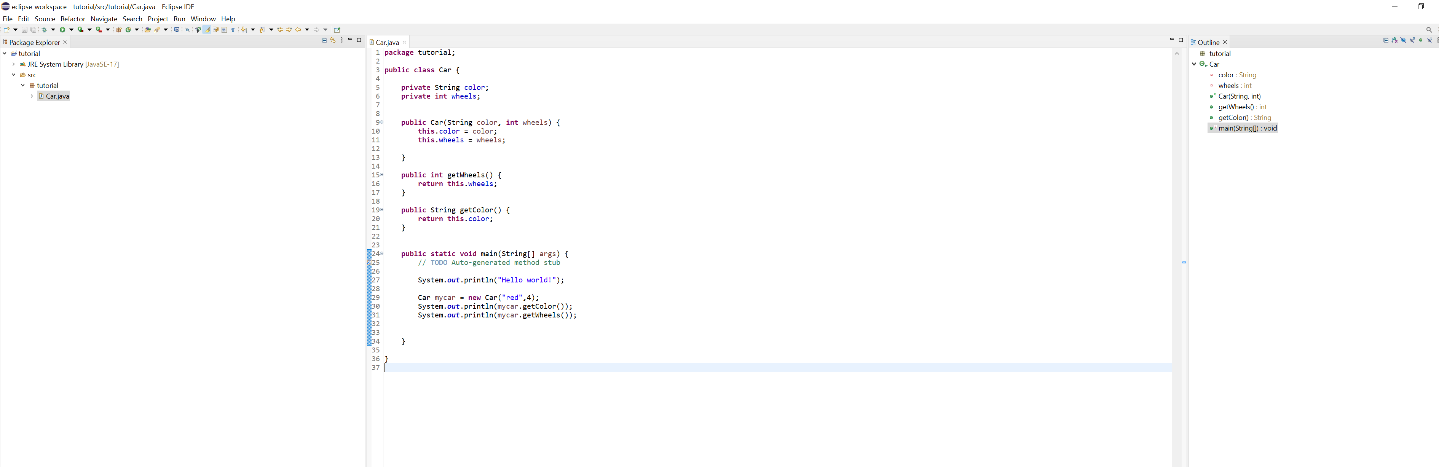
IDE
You will need to download an IDE that you can write Java programs in
Eclipse (I will use this one)
Netbeans
IntelliJ

Slide 75
Academic Misconduct
Plagiarism and cheating is very not cool
You are not allowed to submit something that is not your own, and you are not allowed to steal solutions from another person and modify it
I have a Chegg and Course Hero membership. Don’t try it
Using small snippets of code from the internet is acceptable (but should not be needed). If you do use a small snippet of code from the internet, you should leave a reference as a comment in your code
Do not use any tools or AI that will write code for you

Slide 76

Collaboration Policy
All labs will be individual submissions.
For programs, you are allowed to work with one partner.
When it comes to labs, you may
Share ideas with other students in the class.
Work together on labs in the same physical location.
Help other students troubleshoot problems.
Give hints or provide textbook page numbers/slide numbers to students seeking help
You may NOT
Share your code and solutions directly with other students.
Submit solutions that you did not write.
Modify another student's solution and claim it as your own.
Share your report or solutions directly on Discord

Slide 77


Additional MSU Resources:
https://www.cs.montana.edu/pearsall/classes/msu_resources.html
“Not everyone can become a great artist, but a great artist can come from anywhere”

Slide 78
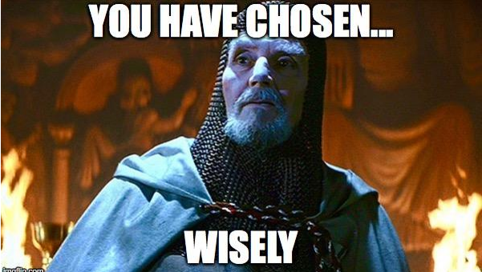
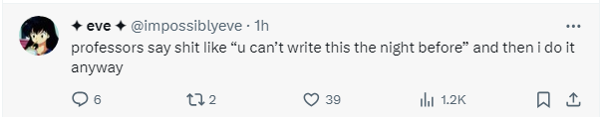
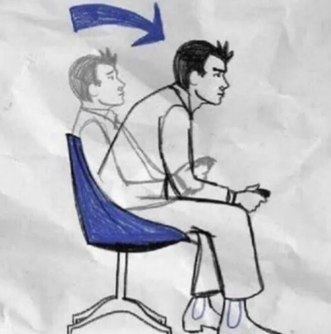

How to do well in this class
Get help when you need it
Lock in
Get started on assignments early (especially programs)!
Come to class and office hours
Take care of yourself

Slide 79
How to do well in this class
Get help when you need it
Lock in
Get started on assignments early (especially programs)!
Come to class and office hours
Take care of yourself
Try to have fun
I am here for you, and I am willing to do whatever it takes to help you succeed!

Slide 80
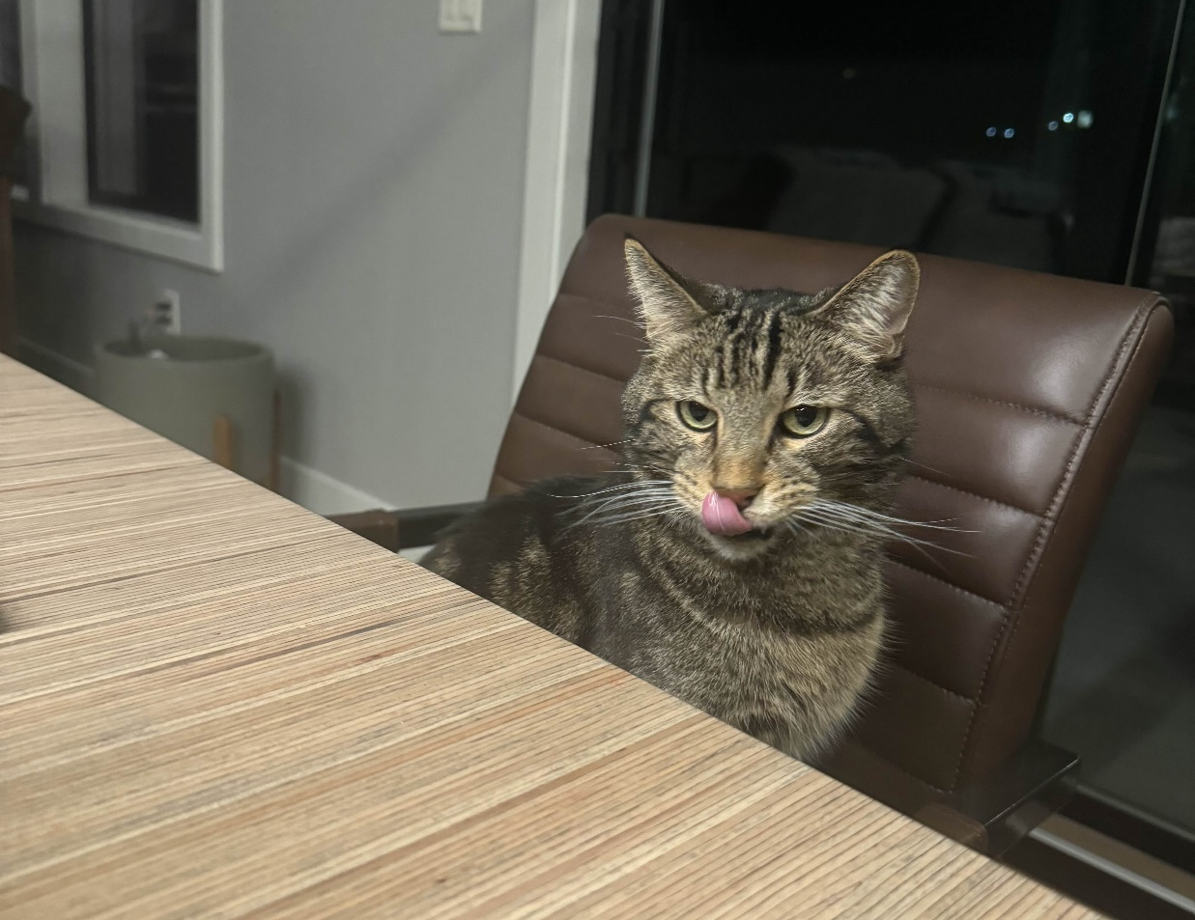
Questions?
Meatball wishes you good luck on this upcoming semester

